Slide 1
Chi-square Test

Slide 2
Chi-square test
We have already used this distribution to study the population variance.
This time, we will develop several tests based on the counts of our sampling units that fall in various categories.
The general principle developed to compare the observed counts against the expected counts via the chi-square statistic

Slide 3
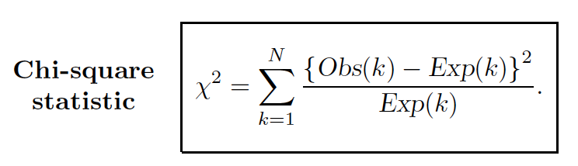
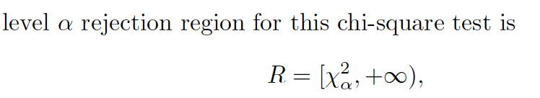
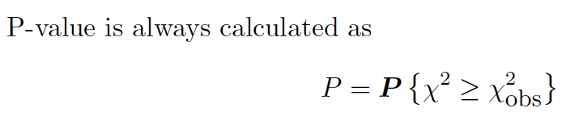
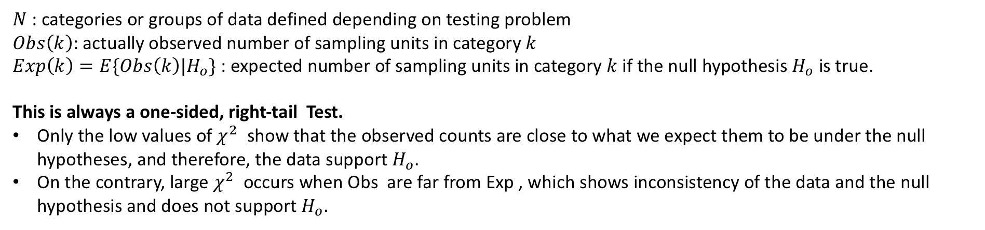
Chi-square statistic
$N$ : categories or groups of data defined depending on testing problem
$Obs\left(k\right)$: actually observed number of sampling units in category $k$
$Exp\left(k\right)=E\{Obs\left(k\right)|H_{o}\}$: expected number of sampling units in category $k$ if the null hypothesis $H_{o}$ is true.
This is always a one-sided, right-tail Test.
Only the low values of $χ^{2}$ show that the observed counts are close to what we expect them to be under the null hypotheses, and therefore, the data support $H_{o}$.
On the contrary, large $χ^{2}$ occurs when Obs are far from Exp , which shows inconsistency of the data and the null hypothesis and does not support $H_{o}.$

Slide 4
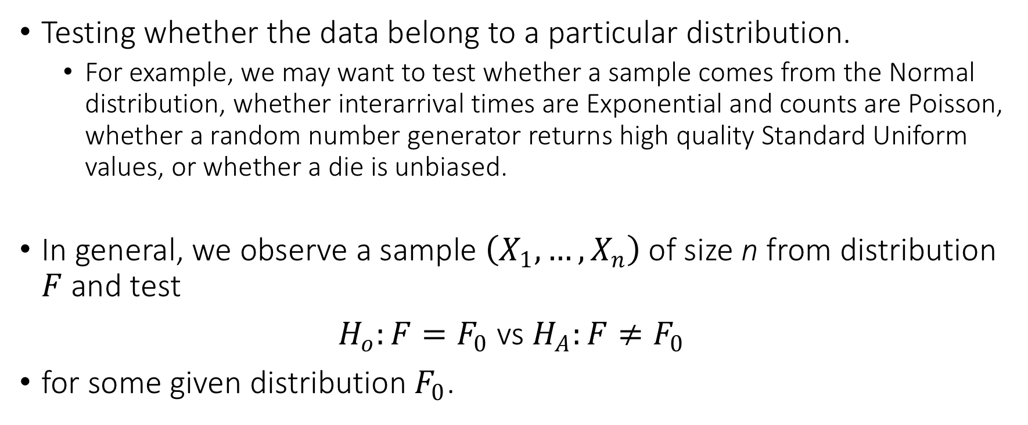
Testing a distribution
Testing whether the data belong to a particular distribution.
For example, we may want to test whether a sample comes from the Normal distribution, whether interarrival times are Exponential and counts are Poisson, whether a random number generator returns high quality Standard Uniform values, or whether a die is unbiased.
In general, we observe a sample $\left(X_{1},…,X_{n}\right)$of size n from distribution $F$ and test
$H_{o}:F=F_{0}$ vs $H_{A}:F≠F_{0}$
for some given distribution $F_{0}$.

Slide 5
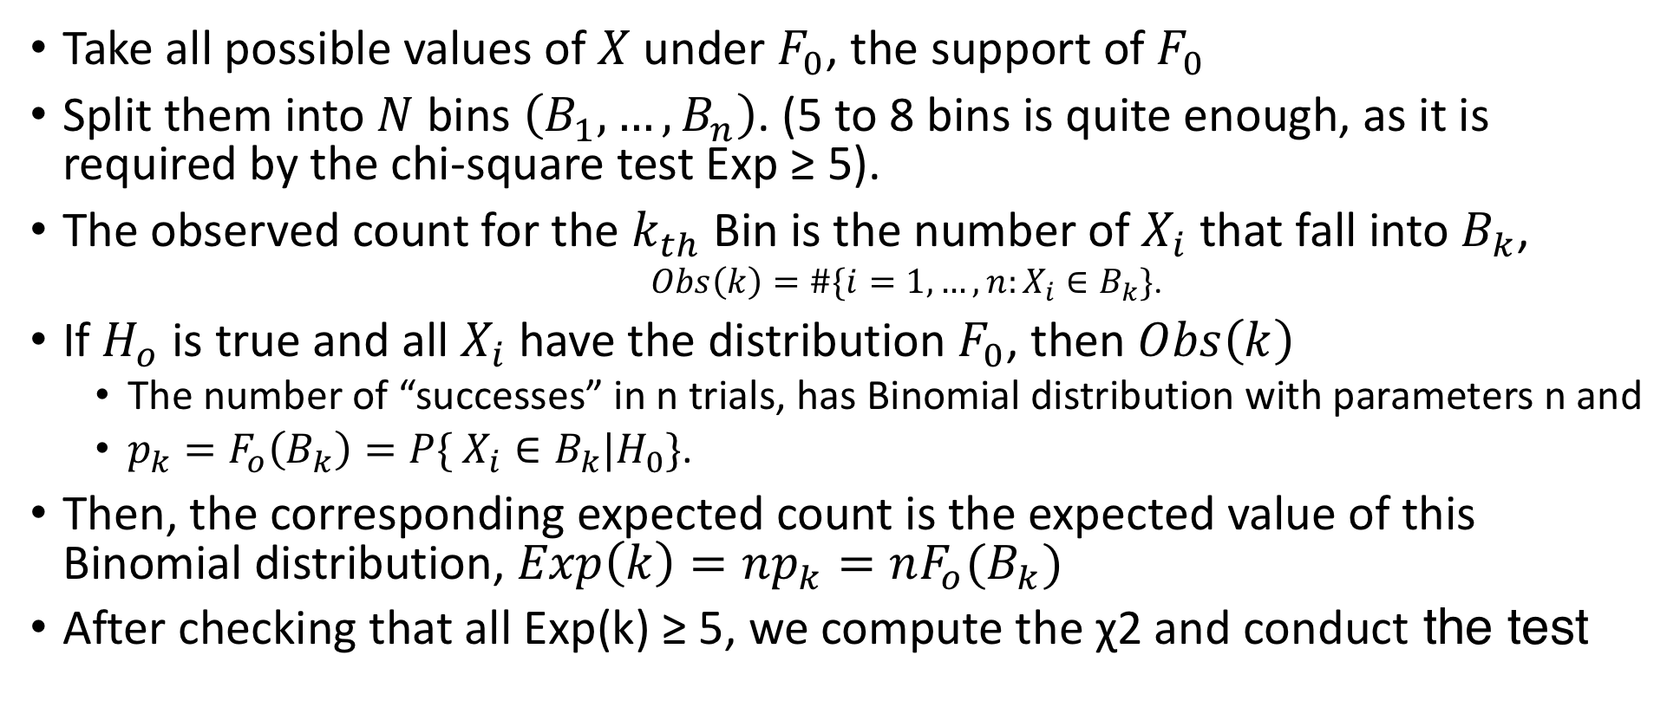
Testing a distribution cont.
Take all possible values of $X$ under $F_{0}$, the support of $F_{0}$
Split them into $N$ bins $\left(B_{1},…,B_{n}\right)$. (5 to 8 bins is quite enough, as it is required by the chi-square test Exp ≥ 5).
The observed count for the $k_{th}$ Bin is the number of $X_{i}$ that fall into $B_{k}$,
$Obs\left(k\right)=\#\{i=1,…,n:X_{i}∈B_{k}\}$.
If $H_{o}$ is true and all $X_{i}$ have the distribution $F_{0}$, then $Obs\left(k\right)$
The number of “successes” in n trials, has Binomial distribution with parameters n and
$p_{k}=F_{o}\left(B_{k}\right)=P\{ X_{i}∈B_{k}|H_{0}\}\text{.}$
Then, the corresponding expected count is the expected value of this Binomial distribution, $Exp\left(k\right)=np_{k}=nF_{o}(B_{k})$
After checking that all Exp(k) ≥ 5, we compute the χ2 and conduct the test

Slide 6
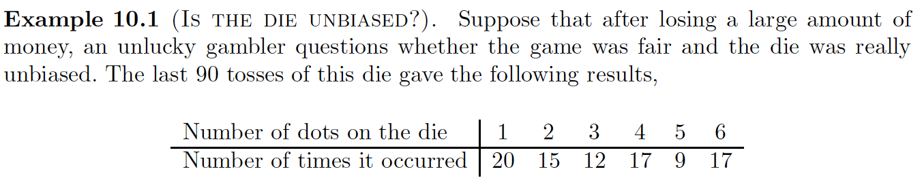

Slide 7
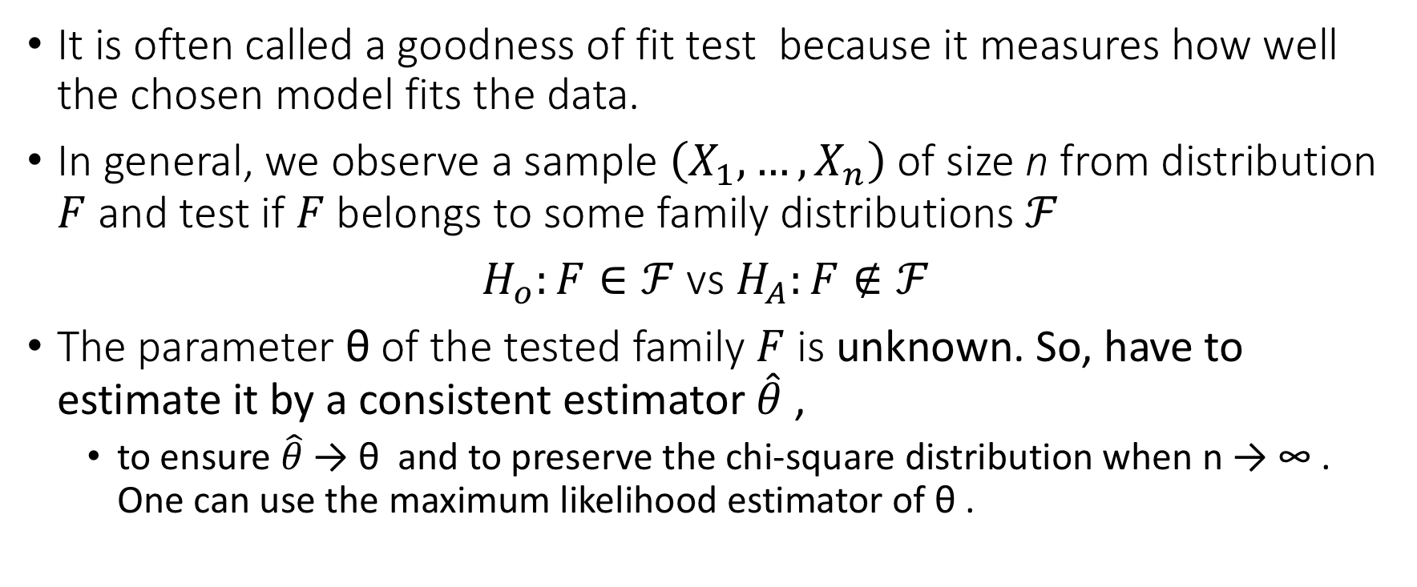
Testing a family of distributions
It is often called a goodness of fit test because it measures how well the chosen model fits the data.
In general, we observe a sample $\left(X_{1},…,X_{n}\right)$of size n from distribution $F$ and test if $F$belongs to some family distributions $ℱ$
$H_{o}:F∈ℱ$ vs $H_{A}:F∉ℱ$
The parameter θ of the tested family $F$ is unknown. So, have to estimate it by a consistent estimator $\hat{θ}$ ,
to ensure $\hat{θ}$ → θ and to preserve the chi-square distribution when n → ∞ . One can use the maximum likelihood estimator of θ .

Slide 8
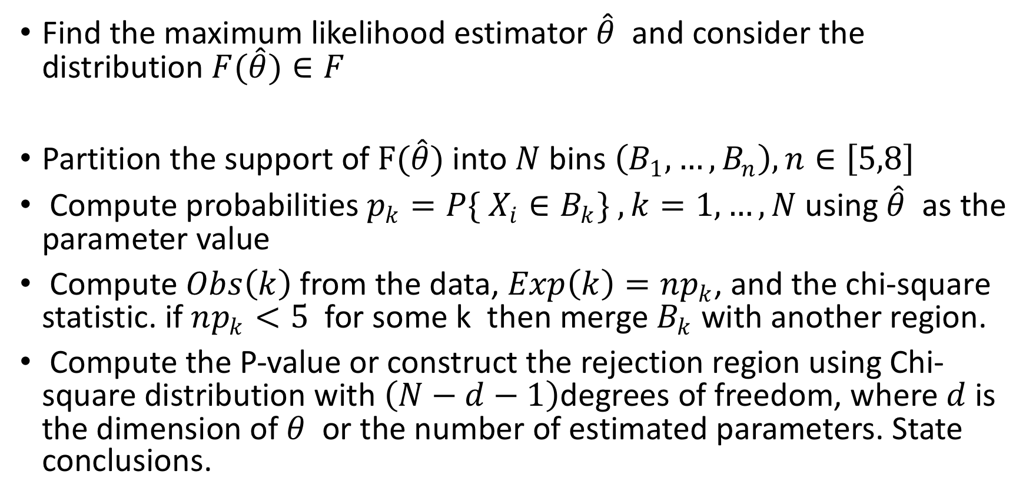
Testing a family of distributions Cont.
Find the maximum likelihood estimator $\hat{θ}$ and consider the distribution $F(\hat{θ})∈F$
Partition the support of $F(\hat{θ})$into $N$ bins $\left(B_{1},…,B_{n}\right), n∈\left[5,8\right]$
Compute probabilities $p_{k}=P\{ X_{i}∈B_{k}\} , k=1,…,N$ using $\hat{θ}$ as the parameter value
Compute $Obs\left(k\right)$from the data, $Exp\left(k\right)=np_{k}$, and the chi-square statistic. if $np_{k}<5$ for some k then merge $B_{k}$ with another region.
Compute the P-value or construct the rejection region using Chi-square distribution with $\left(N−d−1\right)$degrees of freedom, where $d$is the dimension of $θ$ or the number of estimated parameters. State conclusions.

Slide 9
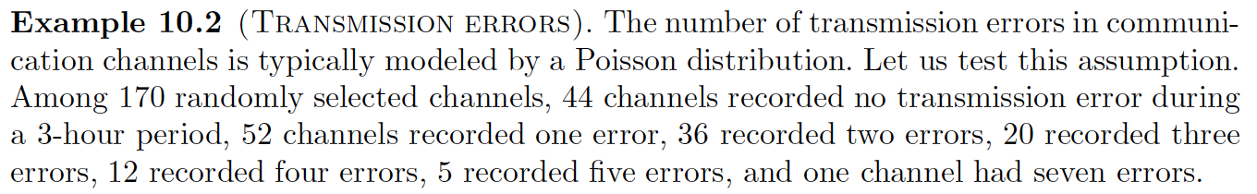

Slide 10
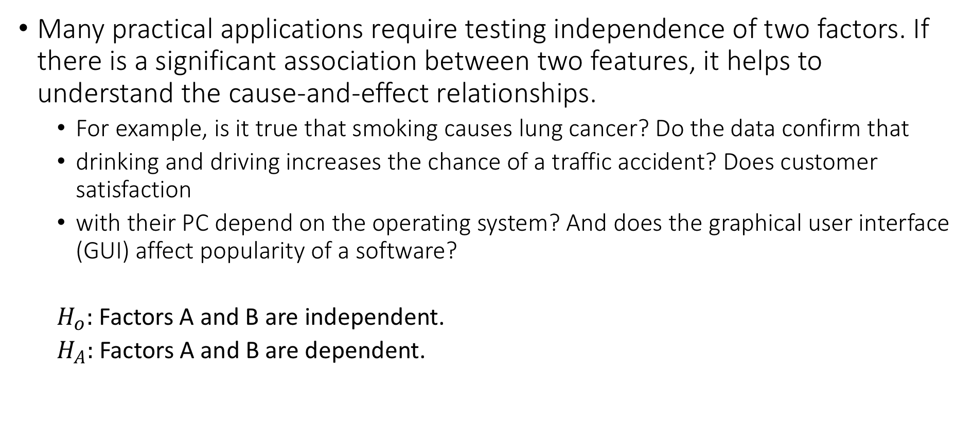
Testing independence
Many practical applications require testing independence of two factors. If there is a significant association between two features, it helps to understand the cause-and-effect relationships.
For example, is it true that smoking causes lung cancer? Do the data confirm that
drinking and driving increases the chance of a traffic accident? Does customer satisfaction
with their PC depend on the operating system? And does the graphical user interface (GUI) affect popularity of a software?
$H_{o}:$ Factors A and B are independent.
$H_{A}:$Factors A and B are dependent.

Slide 11
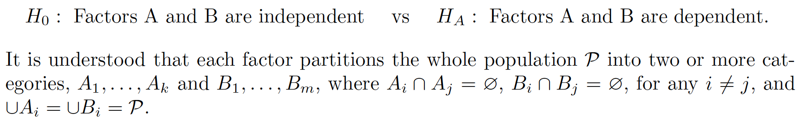
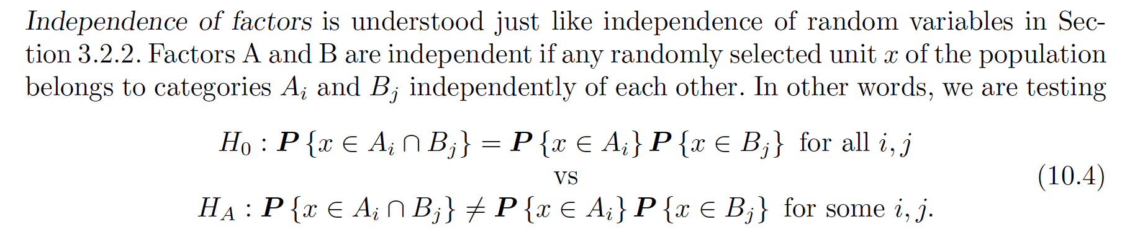
Testing independence Cont.

Slide 12
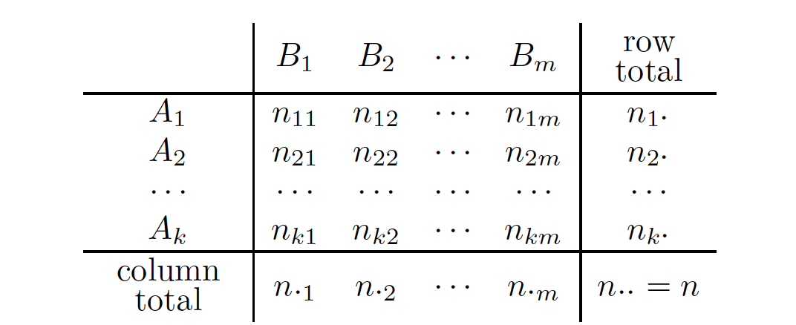
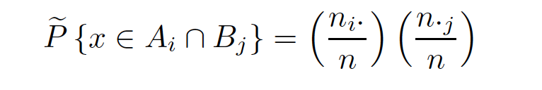
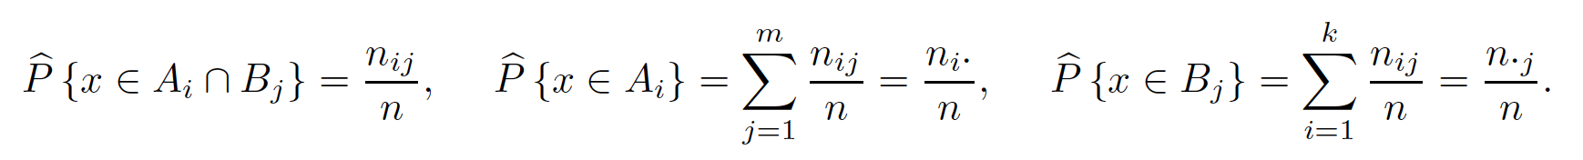
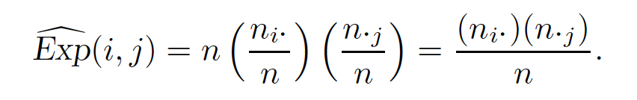
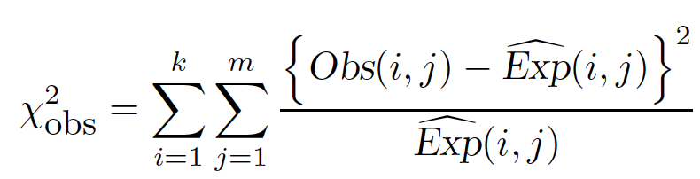

Slide 13
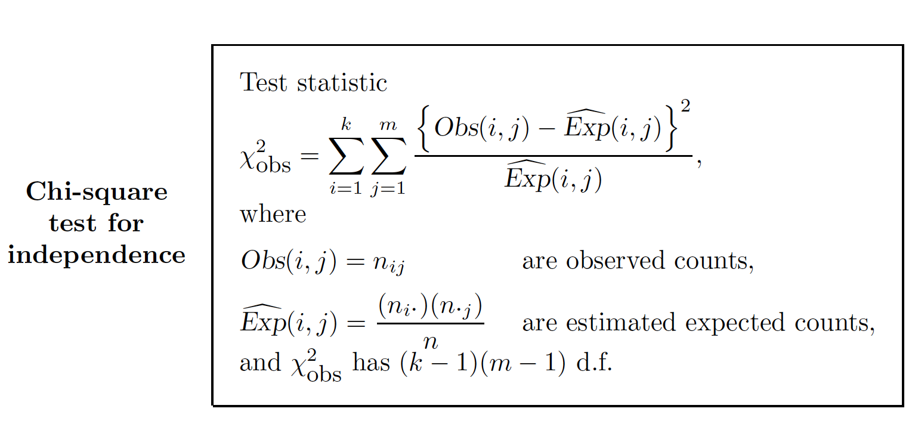

Slide 14
